Slide 1
BFS Breadth First Search

Slide 2
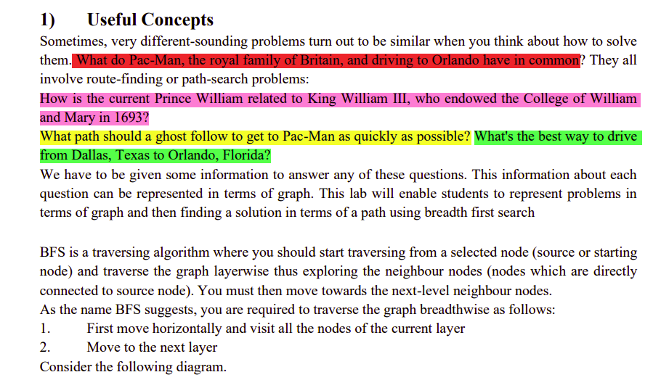

Slide 3
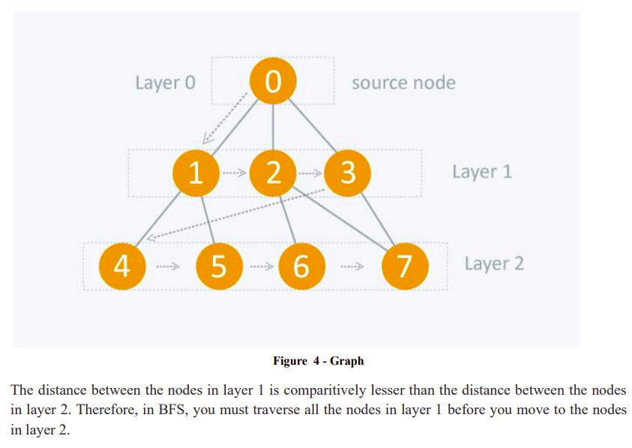

Slide 4
1. Graph Representation
The graph is represented as a dictionary where each key is a node, and the corresponding value is a list of nodes that are directly connected to it.
graph = {
'A': ['B', 'C'],
'B': ['D', 'E'],
'C': ['F'],
'D': [],
'E': ['F'],
'F': []
}
2. Starting Node
We begin the BFS from a specific node, called the starting node. In this example,
'A' is the starting node.
start = 'A'

Slide 5
4. BFS Algorithm Execution
The core of BFS is a loop that continues until there are no more nodes to explore (i.e., the queue is empty).
while queue:
node = queue.popleft()
queue.popleft() Removes and returns the leftmost node in the queue. This is the node we are currently exploring

Slide 6
5. Node Processing
Once a node is dequeued, it is checked whether it has been visited:
if node not in visited:
print(node)
visited.add(node) # Mark the node as visited
If the node has not been visited, we "process" it (in this case, by printing it) and then add it to the
visited set to mark it as visited.

Slide 7
6. Enqueue Adjacent Nodes
After processing the current node, all its adjacent nodes (i.e., its neighbors in the graph) are enqueued, but only if they haven’t been visited yet
for neighbor in graph[node]:
if neighbor not in visited:
queue.append(neighbor)

